Slide 1
Chapter 9
Federated Learning for Privacy-Preserving Internet of Things

Slide 2

Definition of Federated Learning
Aggregation Technique | Challenge | Primary notion | Discussion
FedSGD | Statistical | Based on the configurations large-batch synchronous stochastic gradient descent. | - local gradients are shared instead of parameters - single step of gradient descent is performed per communication round
FedAvg |  | Participants carry out multiple batch upgrades using the local data to upload the updated parameters to the FL servers instead of local gradients. | - Statistically, the FedAvg is demonstrated to diverge under situations where the data is irregularly dispersed among participants. - Systematically, FedAvg did not permit participants to execute varying quantities of local learning depending on relevant restraints.
FedProx |  | The local training for each participant incorporates a proximate factor aiming to restrict the contribution of local upgrades to the global model | - finetune the convergence of models in case of high heterogeneity data. - Like FedAvg, the FedProx did not consider the computing power of participants, and thereby treat them evenly during the aggregation.
FedMA |  | Consider the mutation invariance of the neurons prior to completing the aggregation to facilitate adjustment of the size of the final model. | - Employ Bayesian non-parametric technique to adapt the size of the global network to the heterogeneousness dissemination of data. - The FedMA is susceptible to contaminating attack, in which an opponent could effortlessly trap the federate scheme to enlarge the final network to set up contaminated local network.
FedPAQ | Communication | The participants are allowed to conduct several local parameter updates before sharing the updated parameters with the server. | - FedPAQ compute the global parameters by averaging the local parameters, which necessitates high complication in either greatly convex or non-convex situations.
HierFAVG |  | A tiered participant-edge-cloud aggregation construction in which edge tier aggregate the local updates from the participants, then upload them to the FL server at the cloud. | - This multi-level configuration facilitates effective model interchange throughout the present edge-cloud network. - it is prone to the troubles of laggards and machine failures.
Turbo-Aggregate | Communication and security | A multi-grouping scheme that divides the participants into multiple groups where the parameter upgrades are common between parties in a rotary fashion. A collective trusted communicating method is employed to protect the confidentiality of local data. | - It is relatively appropriate for wireless network topology, where network circumstances and user accessibility can change rapidly. - The employed secure aggregation method is effective in handling user failures, yet unable to acclimate to new participants joining the network. Thus, it necessitates developing a self-configurable protocol to assist new participants by in such a way that preserve the privacy.

Slide 3
Taxonomy of Federated Learning solutions
Aspect | Categories | Advantage | Applications
splitting methodology | FTL | Upsurge the number of samples and expanding the dimensionality | Knowledge transfer, cross-domain learning
 | VFL | Expansion of input dimensionality | Distributed dep learning solutions
 | HFL | Rise the number of samples | Learning on resource-constrained devices
privacy-preservation techniques | Secure parameters aggregation | Escape communicating the initial data | Deep federated solutions
 | Homomorphic encryption | Clients could compute and handle the encoded data | Distributed learning
 | Differential privacy | Could effectively safeguard the confidentiality of users’ data by injecting noise | Privacy preserving artificial intelligence solutions
Heterogeneity handling | Asynchronous communication | Enable handling the communication latency issues | Device heterogeneity
 | Sampling | Evade immediate learning with various IoT devices | Pulling Reduction with Local Compensation (PRLC)
 | Fault-tolerant approaches | Could thwart the entire system from disintegrating | Laying-off techniques, Sensitive applications
 | Heterogeneous design | Could handle the issues related to the heterogeneous devices | 5G, B5G, 6G systems

Slide 4
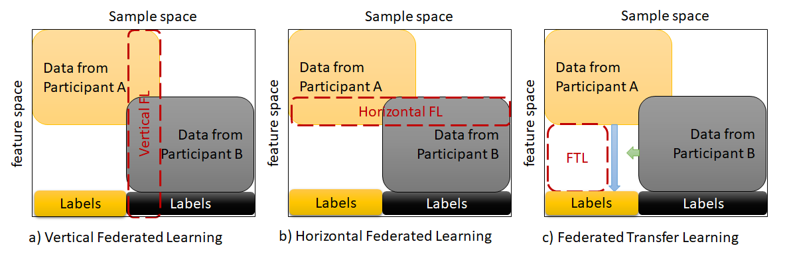
Taxonomy of Federated Learning solutions

Slide 5
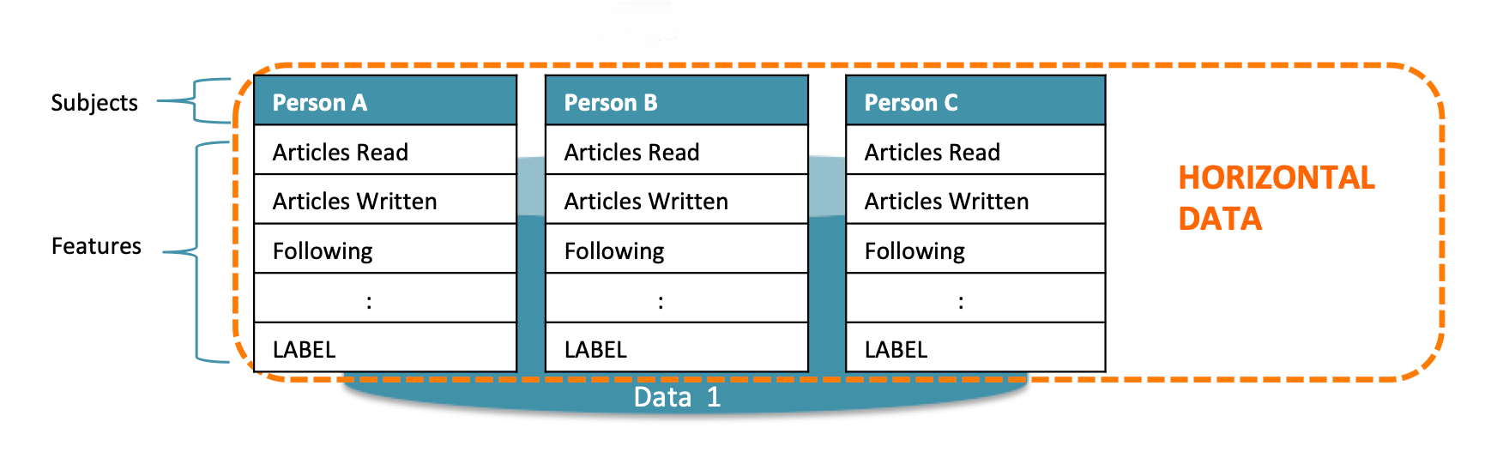
Horizontal federated learning

Slide 6
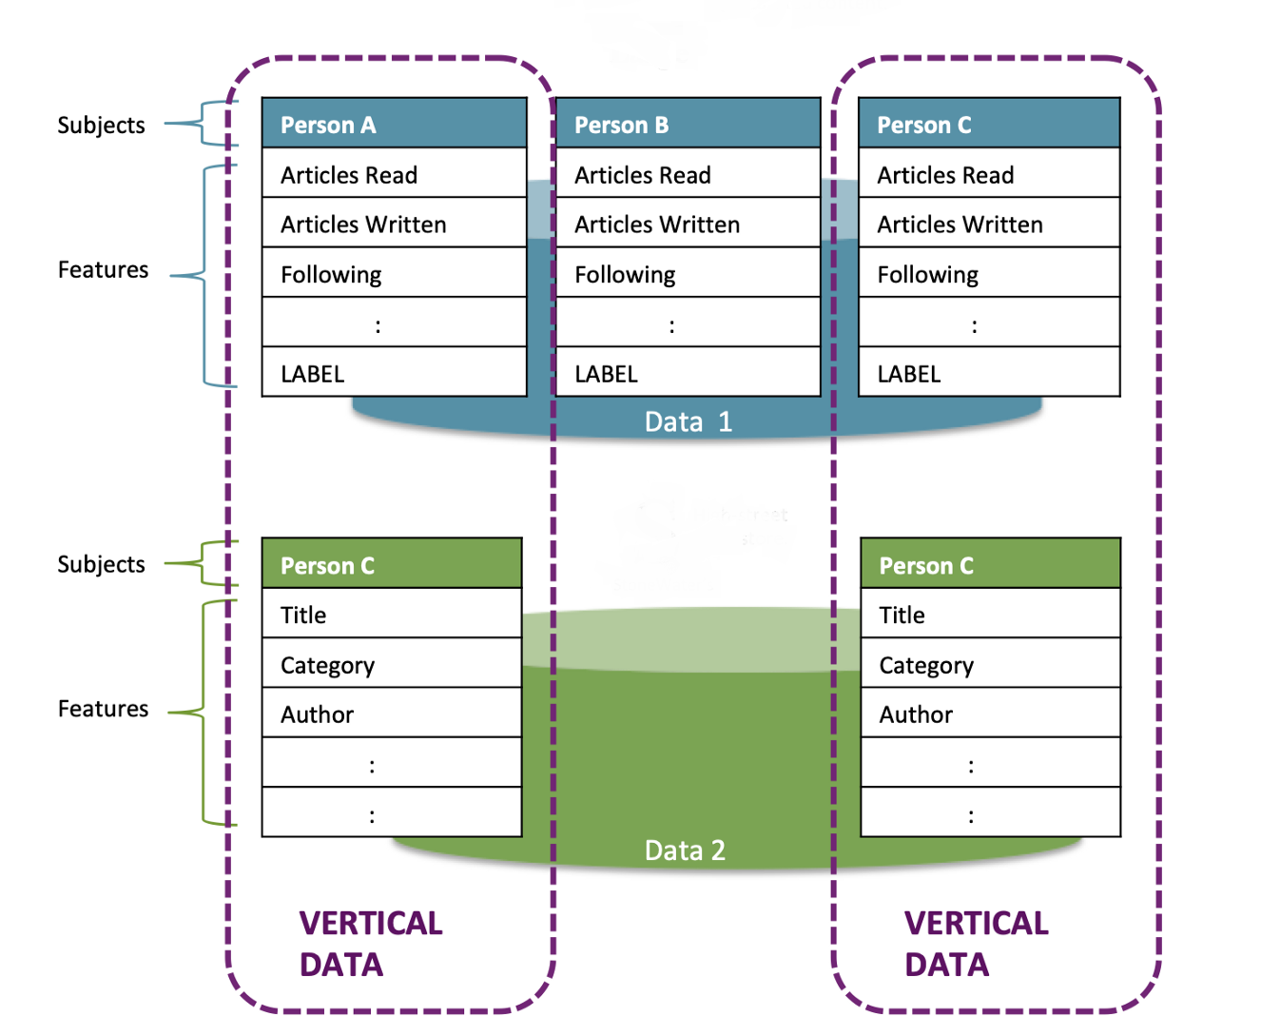
Vertical federated learning

